Slide 1
Beyond the Fight: Unseen Factors That Shape MMA Outcomes
November 14, 2024
Chase Stalcup

Slide 2
Overview
I will be focusing on historic data from the Ultimate Fighting Championship (UFC) to to identify any key factors that may contribute to a fighters success in MMA.
Specifically, I will investigate the following questions:
What demographic or performance characteristics (e.g., average knockdowns, stance) are most strongly associated with winning a fight?
How does the location of the fight influence the outcome?
Are there significant results that may suggest interesting conclusions?

Slide 3
Understanding the problem
Coding
Visualizing
Research
Determine what attributes should be measured and through the use of python coding, developing the means to do so.
Visualizing the data in an accurate and descriptive manner and sharing the findings within the presentation.
Further researching the outcomes and determining the underlying reasons why they exist.

Slide 4
The Ultimate Fighting Championship
The UFC (Ultimate Fighting Championship) is the premier organization for mixed martial arts (MMA) globally. It brings together fighters from diverse disciplines such as boxing, wrestling, jiu-jitsu, and kickboxing to compete under a unified set of rules
Founded in 1993.
Popularized MMA and transformed it into a mainstream sport.
Weight classes
Championship title fights.

Slide 5
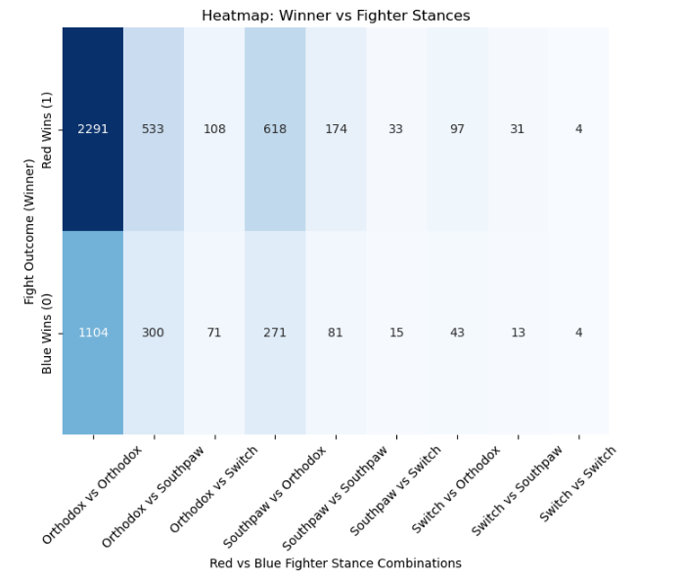
Does fight stance have an impact?
Findings
The P-value is the result from the Chi-square test (chi2_contingency) that determines if there's a statistically significant relationship between two categorical variables, fighter stances and the fight outcome. There is no statistically significant correlation between the winner and the stances.
(p < 0.05)?
Client Implications:
Red 3979
Blue 1923
Draw 110
Chi-square statistic: 11.742670243709457
P-value: 0.16305986561796762
Degrees of freedom: 8

Slide 6
Proposed deliverables
Red vs. Blue
Red is given to the Champion/Higher Rank
Psychologically, red is generally associated with aggressiveness while blue is a calmer and more sophisticated color.
Knockdowns (Gap)
Blue -0.019687
Red 0.010607
Significant Strikes Percentage (Gap)
Blue -0.010673
Red 0.009802
Takedowns (Gap)
Blue -0.023928
Red 0.020469

Slide 7
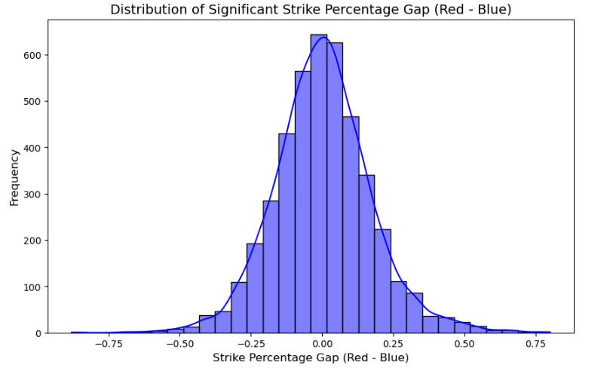
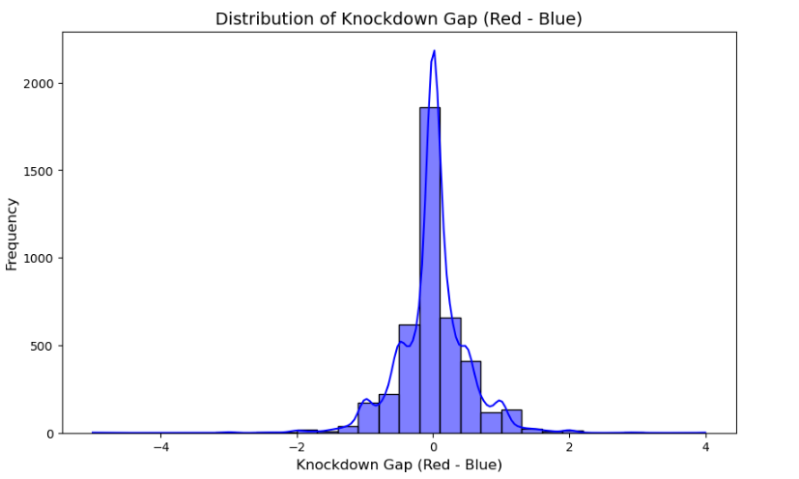
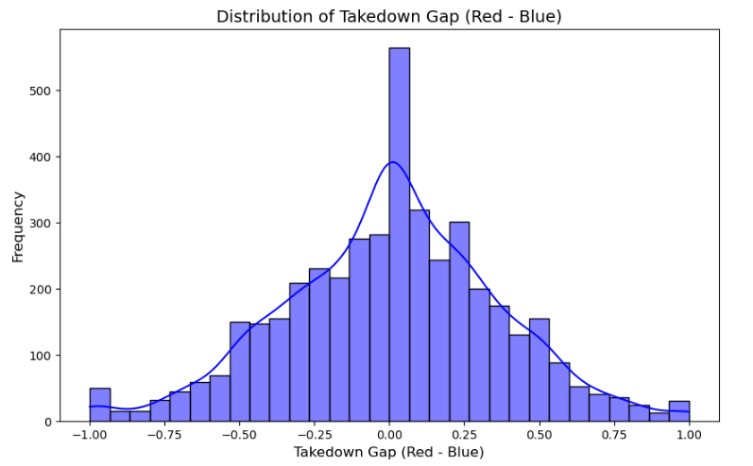
Distributions

Slide 8
Location?
Considering that Las Vegas is known for its sports betting, is it possible that the data is skewed towards the Red corner being declared the winner if they are also typically the betting favorites to win?
Specifically Las Vegas

Slide 9
70%
Of the winners in Las Vegas, Nevada are from the red corner in this dataset

Slide 10
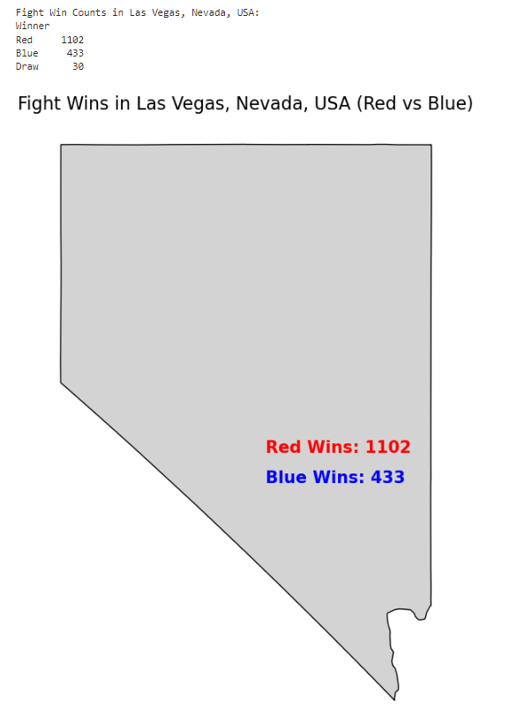
Thoughts?
While it does not 100 percent mean that there is significant influence, the results are surprising. The overall win rate of red corner fighters from this data set is about 60 percent, while using only the data from Las Vegas the number is noticeably higher. The data set does not encompass everything but it is a decent pool to draw statistics from.

Slide 11
Conclusions
Fight stance does not affect the outcome
Definite trends in the data that support the red corner performance
Supported by UFC rankings of their fighters
Possible favoritism shown to betting favorite in Las Vegas?
Nothing is guaranteed but the results are intriguing
In conclusion, my analysis of UFC fight statistics reveals that factors such as location and corner, may have an impact on the outcome of a match, though their significance can vary. While the data provides valuable insights, further research and more comprehensive datasets are needed to fully understand these relationships. Ultimately, the combination of these variables, along with other fight-specific dynamics, contributes to the complex nature of MMA outcomes. Thank you for your attention, and I'm happy to answer any questions you may have.

Slide 12
Sources
Red vs. Blue: A fan's guide to understanding corner color placement. FSMMA. Aakrit Sharma. Apr 19, 2024. https://fansidedmma.com/posts/red-blue-corner-fan-guide-01hvkvq95pp8
Dataset: UFC-Fight historical data from 1993 to 2021. Rajeev Warrier. https://www.kaggle.com/datasets/rajeevw/ufcdata

